Slide 1
Numerical Methods
Nonlinear Equations

Slide 2


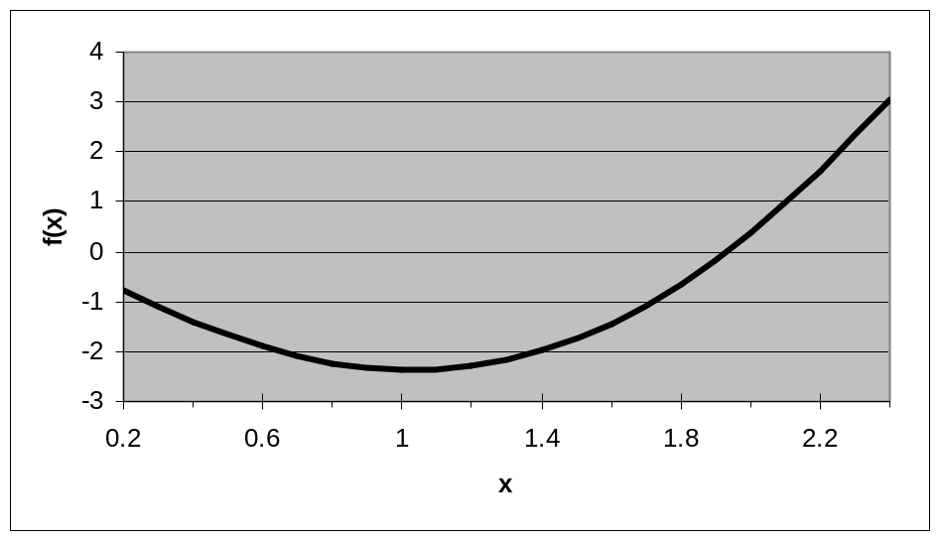
Roots of Equations
Methods for solving nonlinear equations
Example
  x = 1.9 is a root

Slide 3
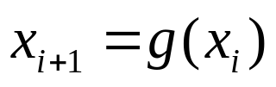
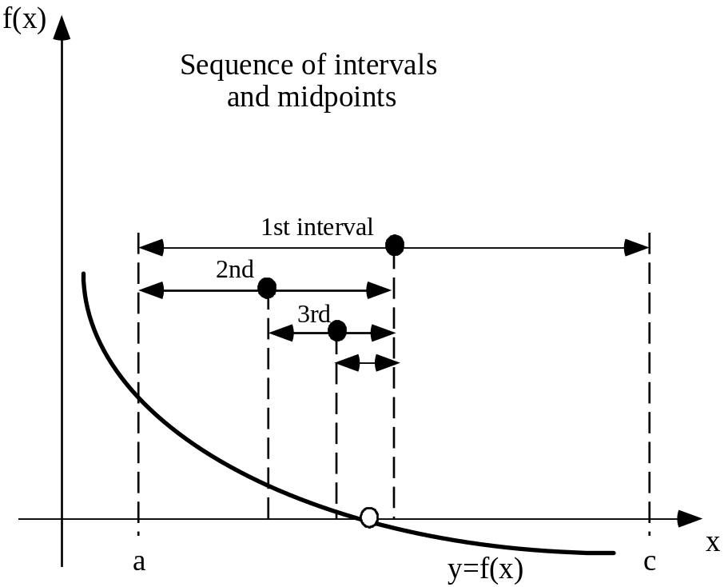
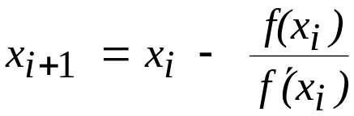
Roots of Equations
Three Methods
  Fixed Point Iteration
  Bisection
  Newton

Slide 4

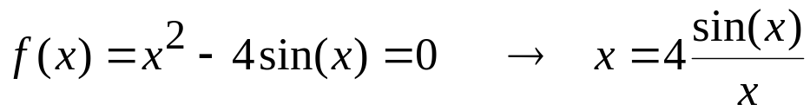
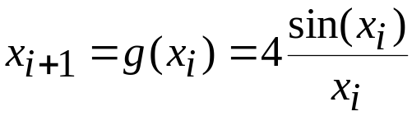
Fixed Point Iteration Method
Finding roots by rearranging the equation
Example
Given an initial guess of a root, x_{i}, compute the new estimate, x_{i+1}

Slide 5
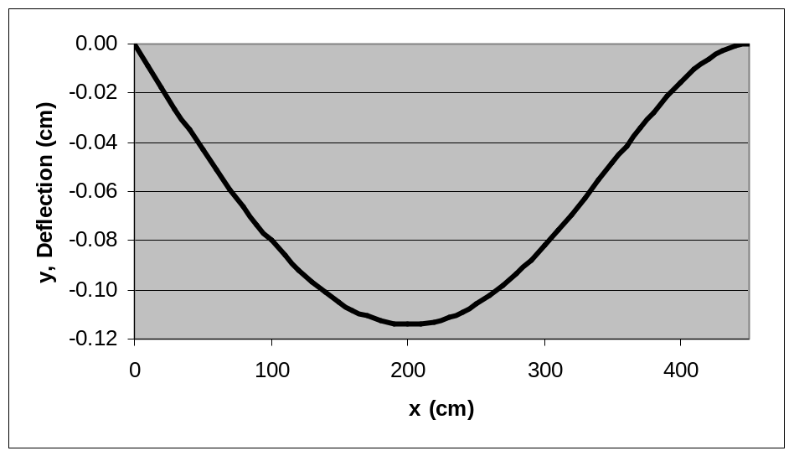
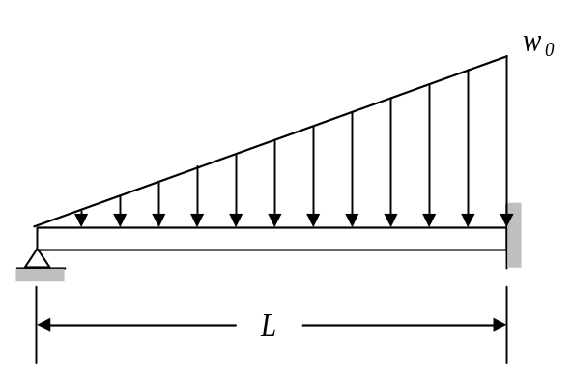
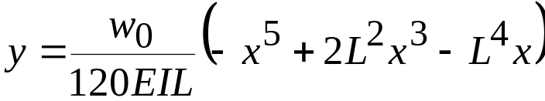
Example – Beam Deflection
Uniform beam subject to linearly increasing, distributed load. Deflection, y
y
x
Given:
w₀ = 1.75 kN/cm
E = 50,000 kN/cm²;
I = 30,000 cm⁴; and
L = 450 cm;
Find: Point (x) of maximum deflection

Slide 6
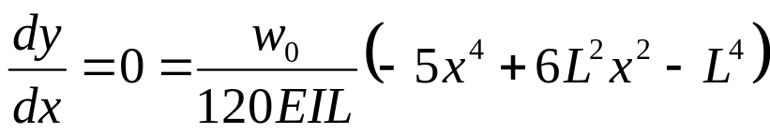
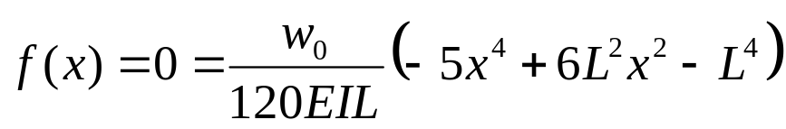

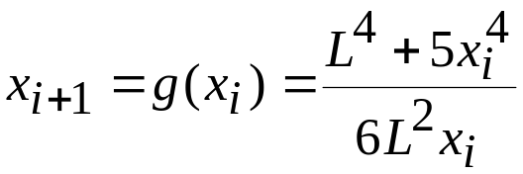
Example – Beam Deflection
Maximum deflection occurs at the point x where
So this is
Rearrange
Fixed point iteration

Slide 7
Example – Beam Deflection
Maximum deflection occurs at x = 201 cm, where y = -0.11 cm

Slide 8
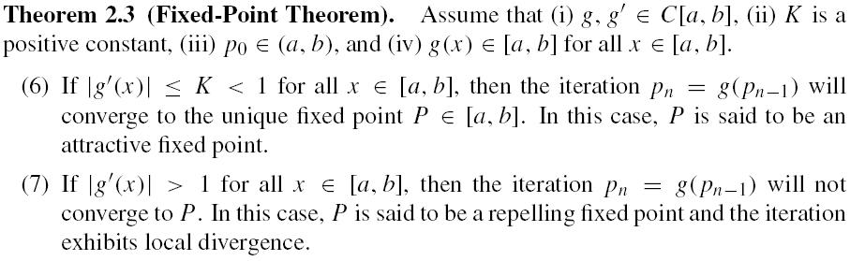
Fixed-Point Theorem (p44)

Slide 9
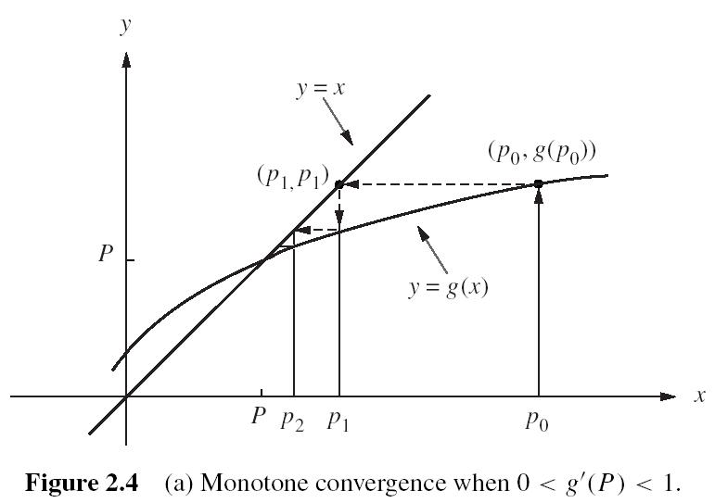
Fixed-Point Theorem (p46)

Slide 10
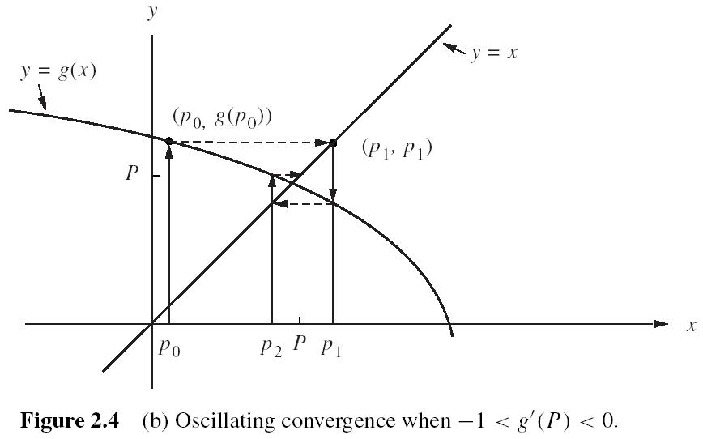
Fixed-Point Theorem (p46)

Slide 11
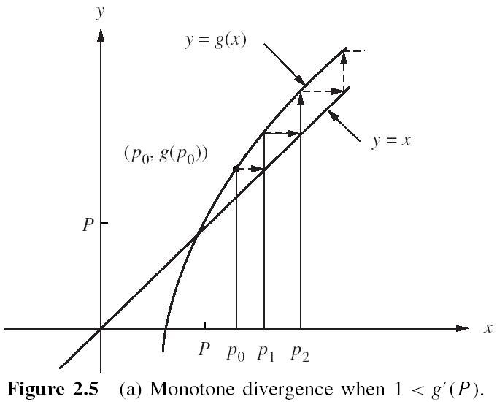
Fixed-Point Theorem (p47)

Slide 12
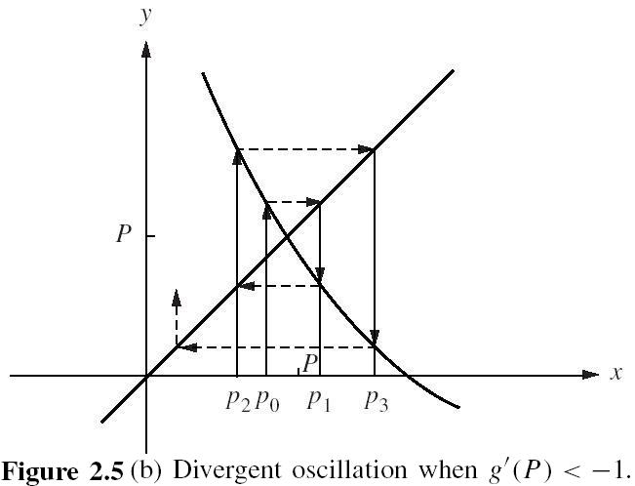
Fixed-Point Theorem (p47)

Slide 13
Reading:
Page 48 – Examples 2.4 and 2.5
Home Assignments:
Page 50 – Exercises 1, 4, 5

Slide 14
Bisection Method
f(x) changes sign on opposite sides of a root
If [a,c] contains a root, then f(a)*f(c) < 0
Method
Bisect the interval
    b=(a+c)/2
Check sign of
    f(a)*f(b)
If f(a)*f(b) < 0,
    [a,b] contains the root
    Set c = b, go to Step 1
  Else
    [b,c] contains the root
    Set a = b, go to Step 1

Slide 15
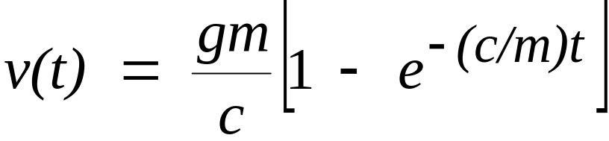
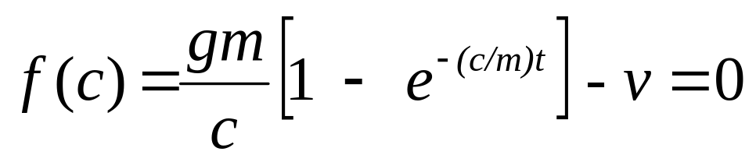
Example – Bisection Method
Determine drag coefficient (c) for an object of mass m to have a velocity v after free-falling for time t
Rearrange:
m = 68.1 kg
v = 40 m/s
t = 10 s

Slide 16
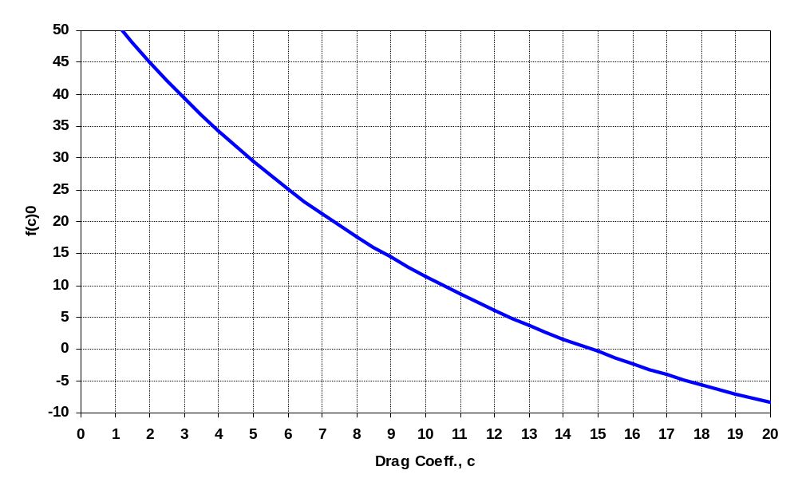
Example - Bisection
Bisect the interval
    b=(a+c)/2
Check sign of
    f(a)*f(b)
If f(a)*f(b) < 0,
    [a,b] contains the root
    Set c = b, go to Step 1
  Else
    [b,c] contains the root
    Set a = b, go to Step 1
a
c

Slide 17
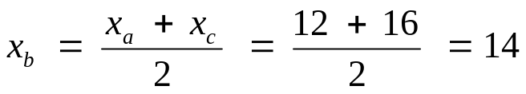
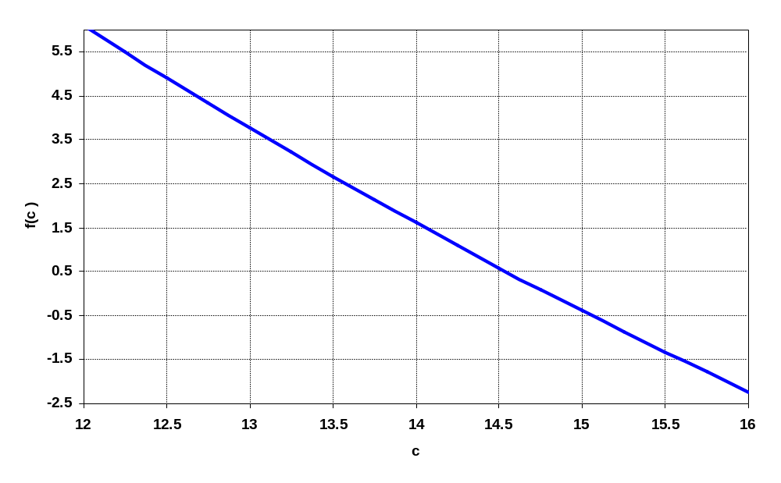
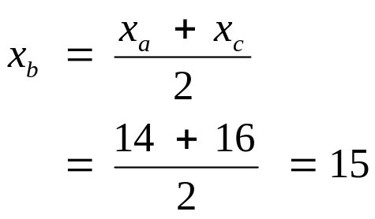
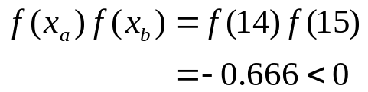
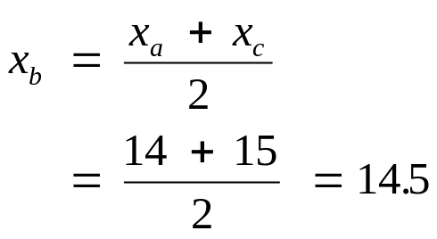
Example - Bisection
Bisect the interval
    b=(a+c)/2
Check sign of
    f(a)*f(b)
If f(a)*f(b) < 0,
    [a,b] contains the root
    Set c = b, go to Step 1
  Else
    [b,c] contains the root
    Set a = b, go to Step 1
x_{a} = 12 and x_{c}= 16
1:
2:
3:

Slide 18
Example - Bisection
Iteration x_{a} x_{c} x_{b}
1 12 16 14
2 14 16 15
3 14 15 14.5
4 14.5 15 14.75
5 14.75 15 14.875
6 14.75 14.875 14.8125

Slide 19
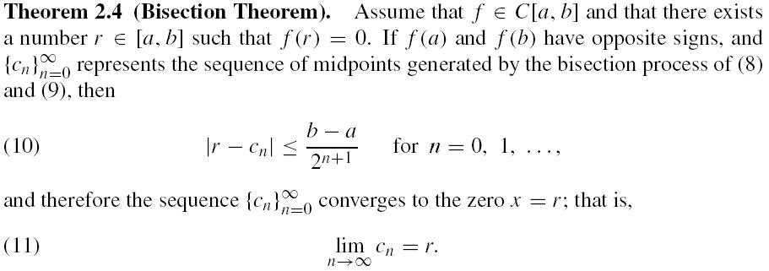
Bisection Theorem (p54)

Slide 20
Reading
Page 56 – false position method.
Home Assignment
Page 61 – Exercises 4, 9 and 11.

Slide 21
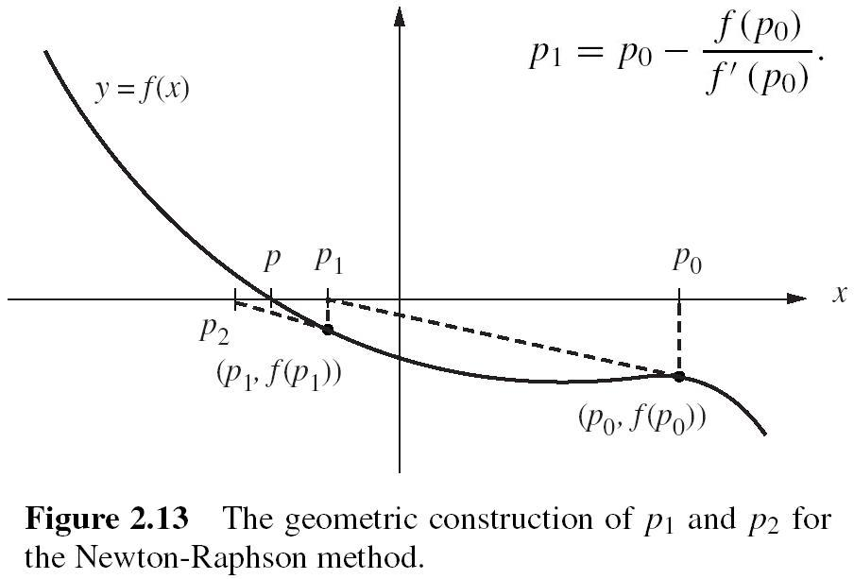
Newton-Raphson Method

Slide 22
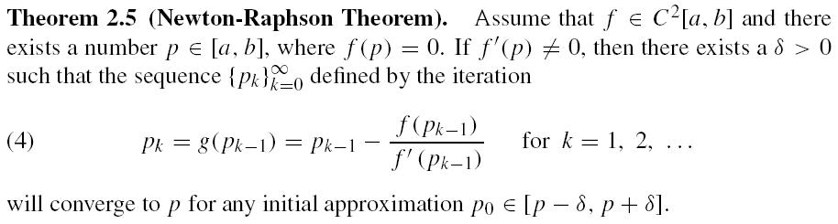
Newton-Raphson Theorem (p71)

Slide 23
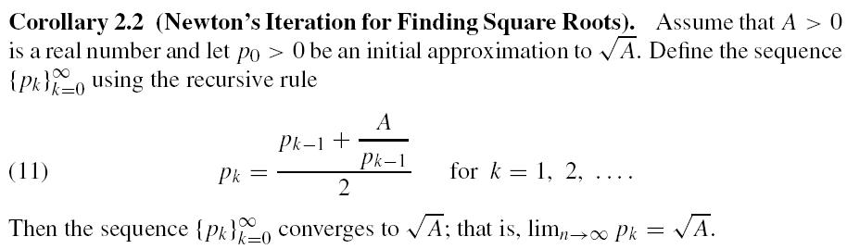
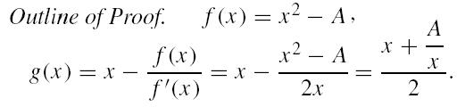
Newton square-root corollary (p72)
See Page 73 – Example 2.11

Slide 24
ZYN research: time-varying square roots finding
[J77] Yunong Zhang, Zhende Ke, Peng Xu, and Chenfu Yi, Time-varying square roots finding via Zhang dynamics versus gradient dynamics and the former's link and new explanation to Newton-Raphson iteration, Information Processing Letters 110 (2010) 1103-1109

Slide 25
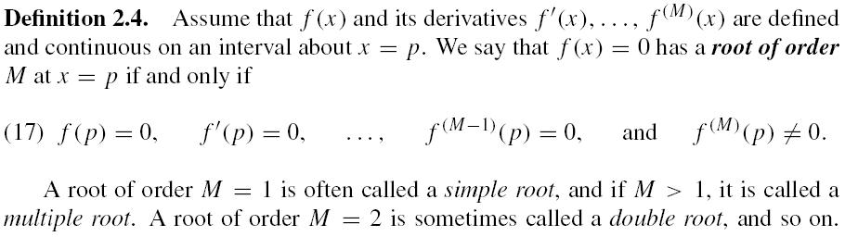
Convergence concepts (p75)

Slide 26
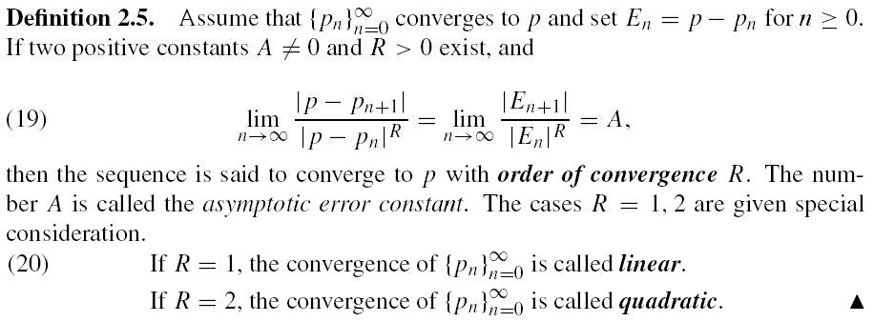
Convergence concepts (p75)

Slide 27
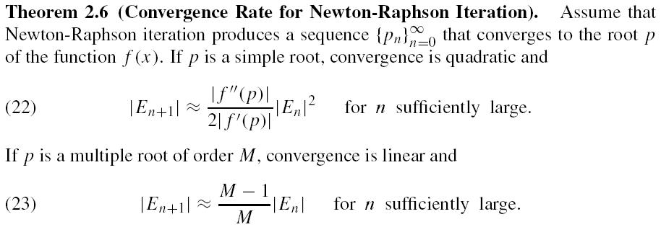
Newton Convergence (p77)

Slide 28
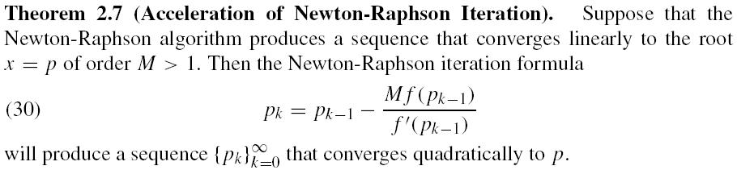
Accelerated Newton Convgce (p82)

Slide 29
Newton Convergence (p79)
Newton-Raphson iteration can produce divergent sequences, cyclic sequences, and so on.
See pages 78 and 79: Figure 2.15.

Slide 30
Reading
Page 80 – secant method.
Home Assignment
Pages 85 and 86 – Exercises 4 and 8.

Slide 31
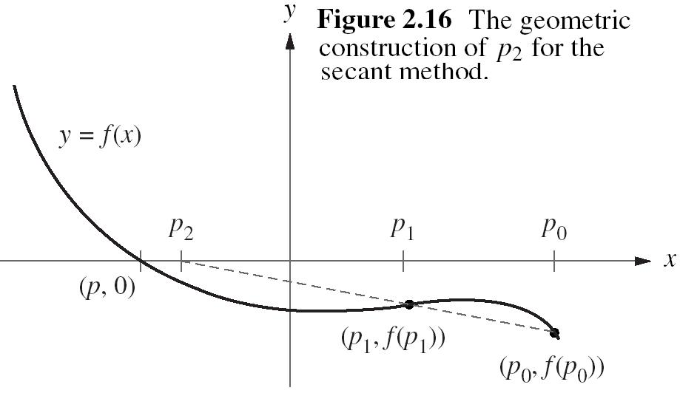
Secant method (p80)

Slide 32
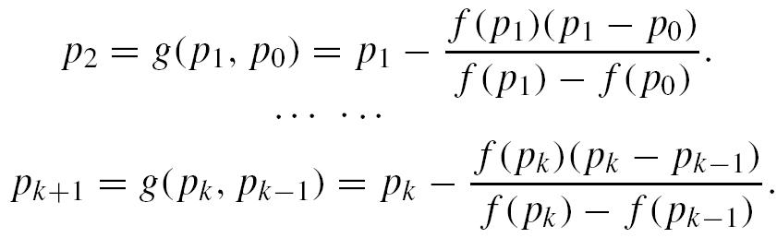
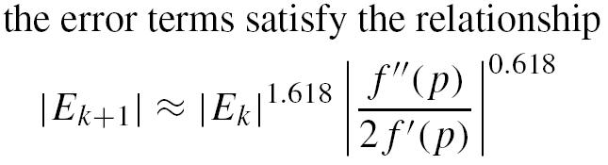
Secant method (p81-82)

Slide 33
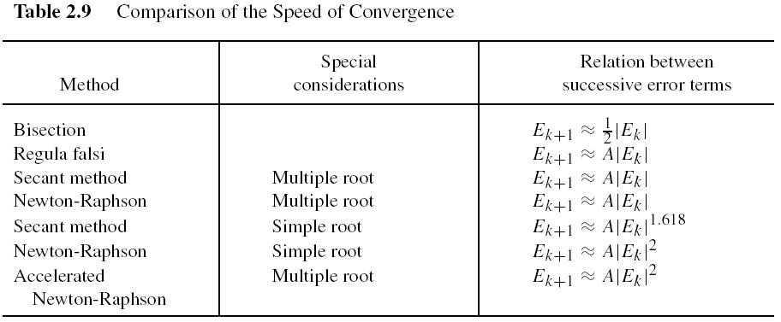

Slide 34
Reading (optional)
Pages 62 – 69: Section 2.3
Home Assignment (optional)
Page 69 – Exercise 1.

